Slide 1
A340 Lecture 9
CSS

Slide 2
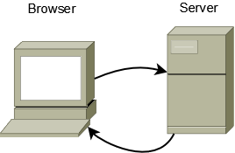
Client-Server Communication in PHP
Browser submits
Requests
Environmental Data
Field values
Server returns
Screen controls
Default values
Suggested links
Static text
External resources
Control buttons

Slide 3
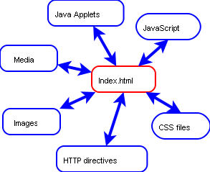
Auxilary components loaded by HTML

Slide 4
CSS
Cascading Style Sheets
Hierarchy of typographic specifications
Browser default
External style sheet
Internal style sheet (inside the <head> tag)
Inline style (inside an HTML element)

Slide 5
Formatting
ASCII unformatted output
Standard HTML
Cascading Style Sheets

Slide 6
Specifying CSS
Browser default
External style sheet <link rel=“stylesheet” type=“text/css” href=“mypagestyle.css”>
Internal style sheet < style><!-- …… --></style>
Inline style <p style=“background:yellow;color:red”>

Slide 7
Examples
http://www.w3schools.com/css/default.asp

